Slide 1
Space Flight

Slide 2
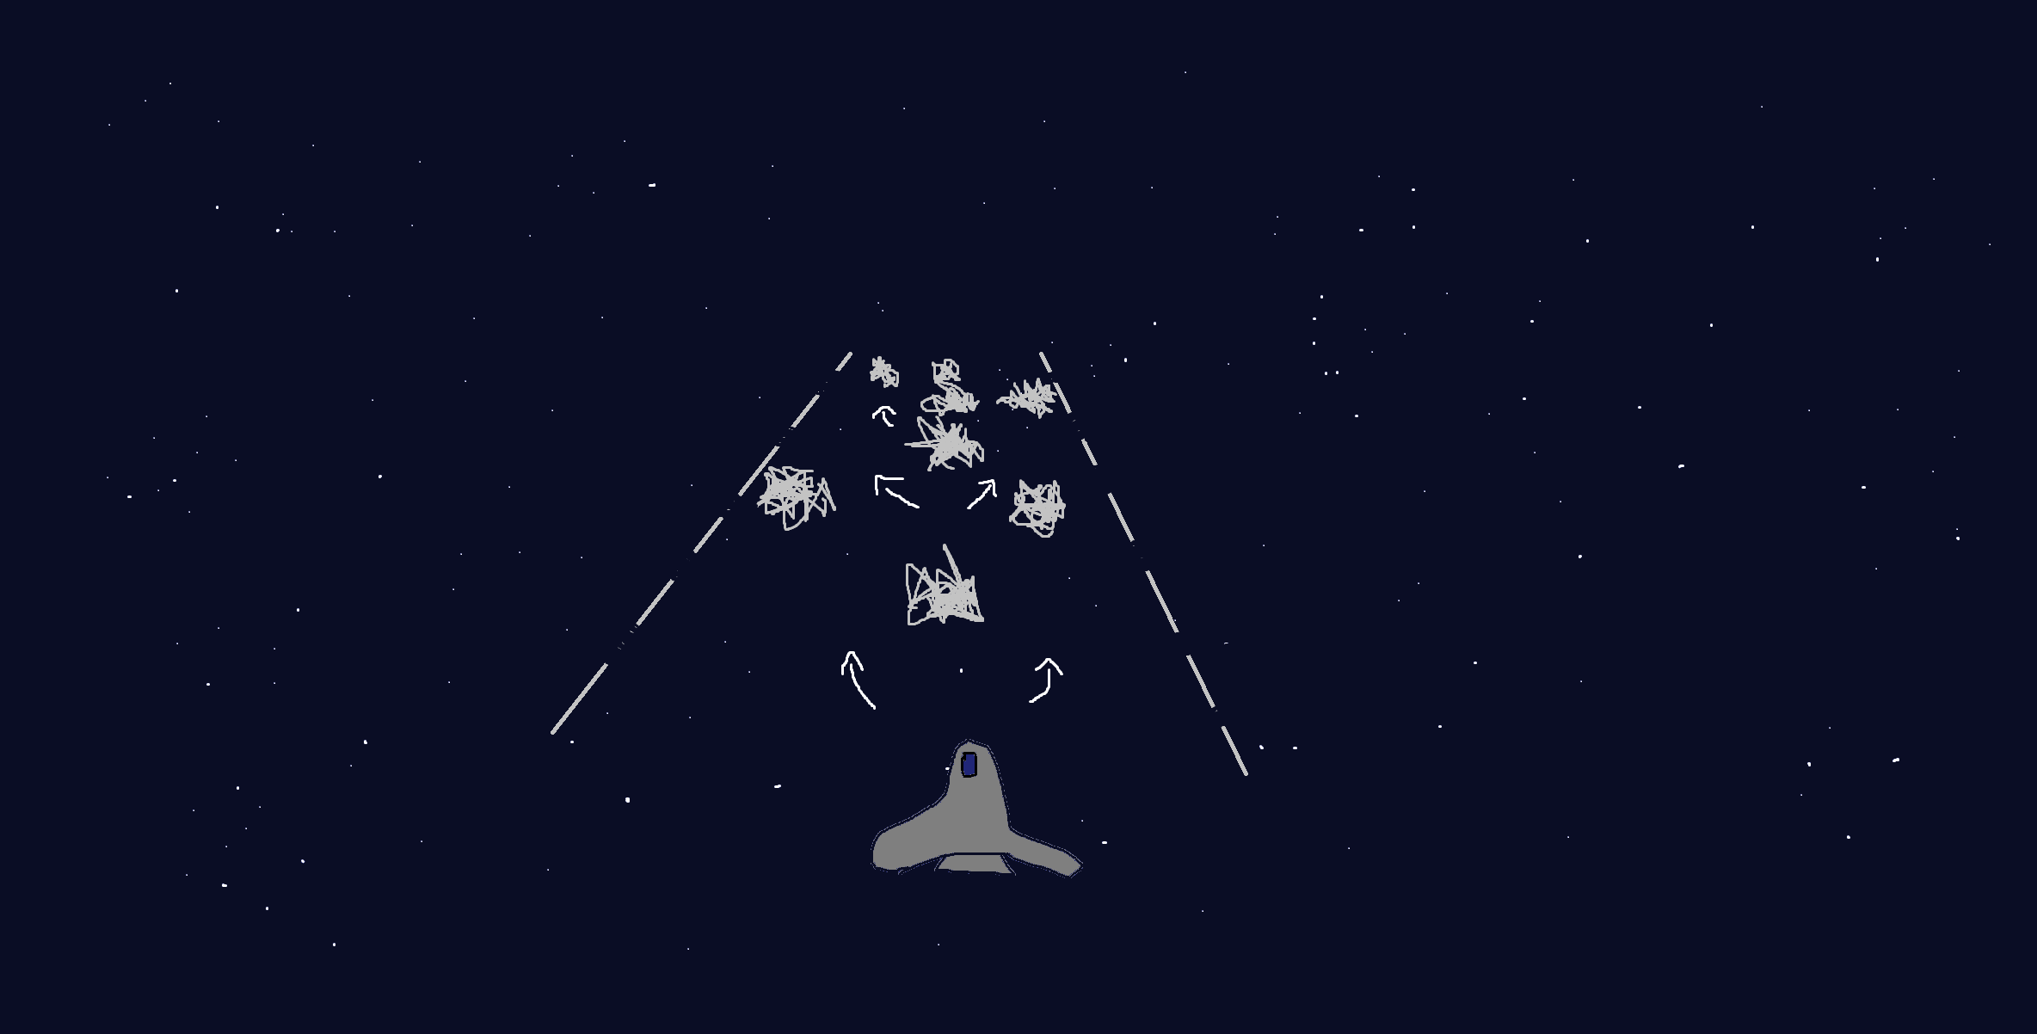
Design and Planning
High Score: 378
Score: 159
Figure 1.0. Game Design Sketch. Shows the planned view during gameplay. A is the player, B are the borders that mark the play area (the players cannot got outside of these), C are just a visualisation of the player movement during gameplay, and D are the obstacles to avoid.

Slide 3
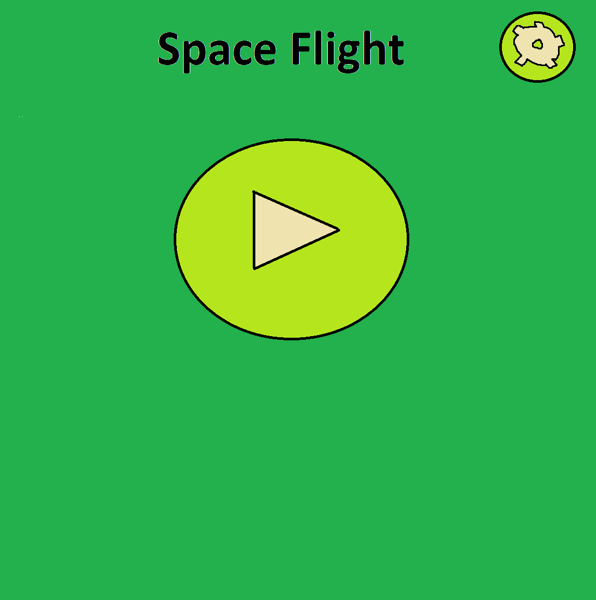
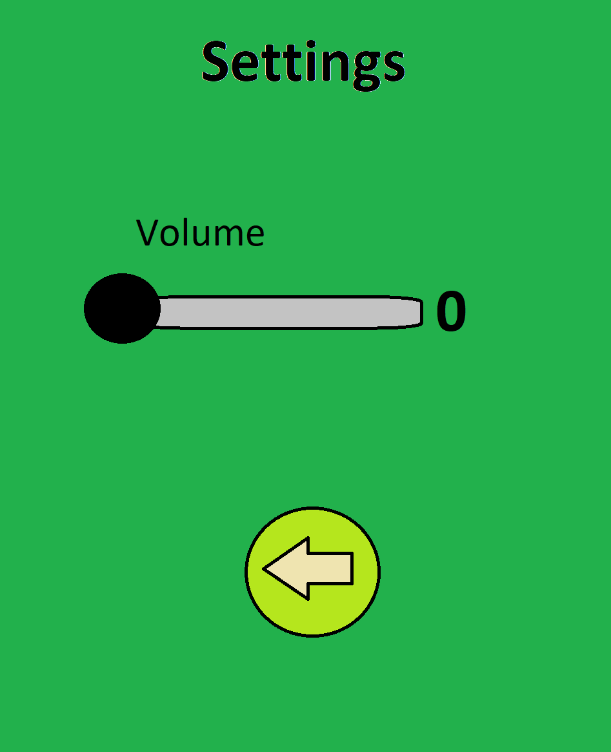
Design and Planning

Slide 4
Early Development

Slide 5

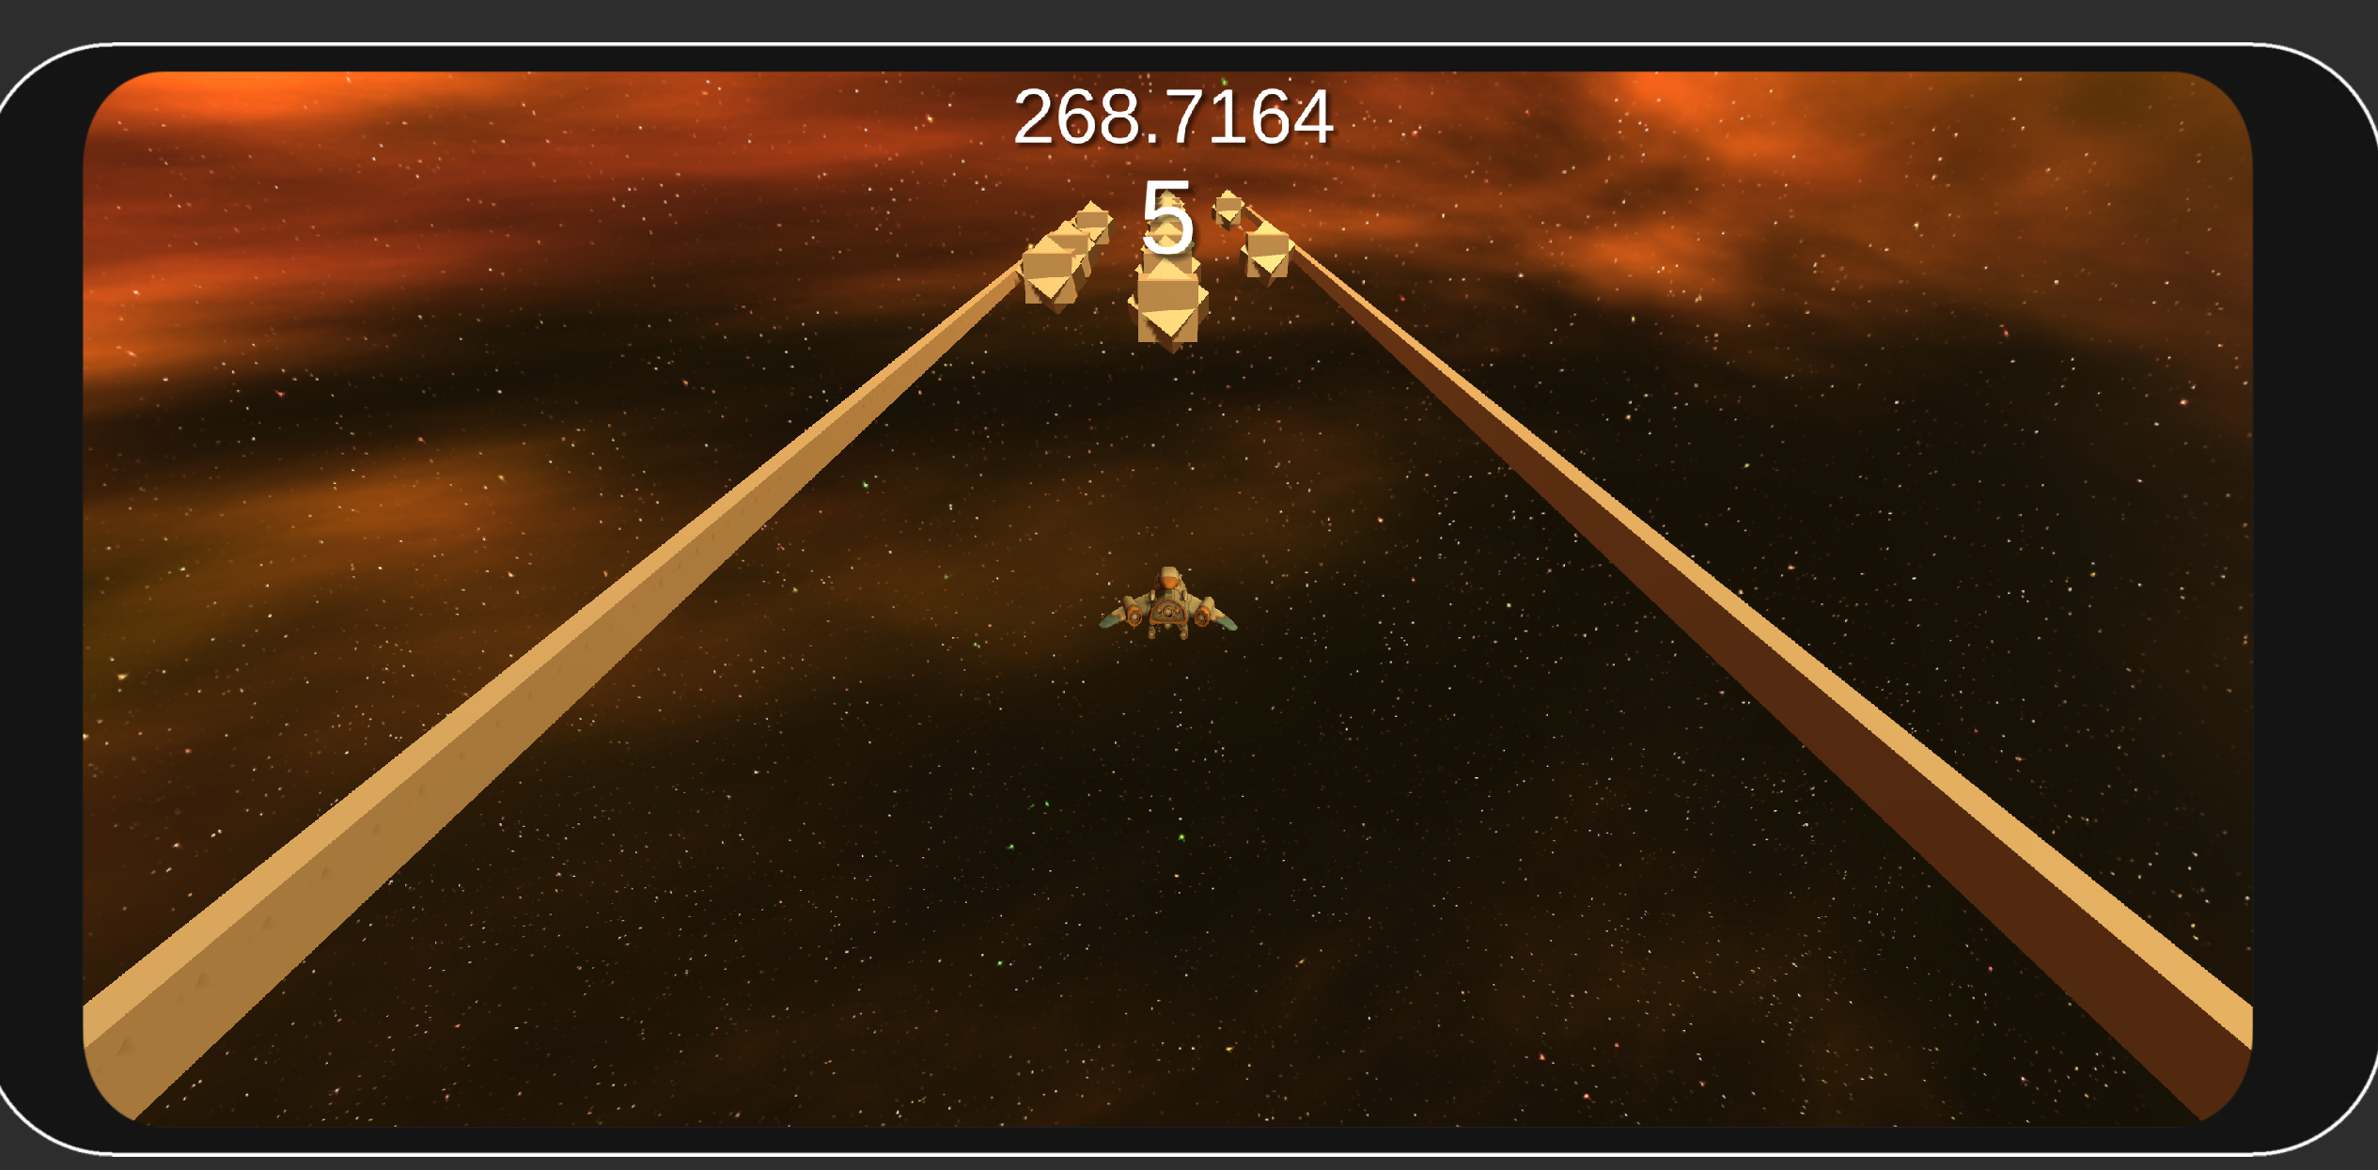
The Prototype

